Slide 1

Mock Test 1
December 2021

Slide 2
indoor/inbound/rate/outbound/outdoor
Tourists visiting places outside their own country is … tourism.
Our guests can use the … pool regardless of the weather.
The special … is offered if you stay for a week.

Slide 3
Tourists visiting places outside their own country is outbound tourism.
Our guests can use the indoor pool regardless of the weather.
The special rate is offered if you stay for a week.

Slide 4
MAKE QUESTIONS
ask about the hotel facilities
ask about the method of settlement

Slide 5
What facilities does the hotel offer?
What facilities are there in the hotel?
How are you going to settle the account?
How do you plan to pay, in cash or by credit card?

Slide 6
F… is when you go to the countryside for your holiday.
T… is organized to bring guests from the hotel to the airport.
G… park is where you can see wild animals.

Slide 7
Farmstay is when you go to the countryside for your holiday.
Transfer is organized to bring guests from the hotel to the airport.
Game park is where you can see wild animals.

Slide 8
AT IN ON
The weather is still pleasant … September.
The plane leaves … 8 … the evening.
My holiday starts … 2nd July.

Slide 9
The weather is still pleasant IN September.
The plane leaves AT 8 IN the evening.
My holiday starts ON 2nd July.

Slide 10
human man non self catering refundable caring made
Built or … attractions are museums, churches etc.
We chose … accommodation so we could try local food.
We lost our deposit because the room was …

Slide 11
human man non self catering refundable caring made
Built or man made attractions are museums, churches etc.
We chose self catering accommodation so we could try local food.
We lost our deposit because the room was non refundable.

Slide 12
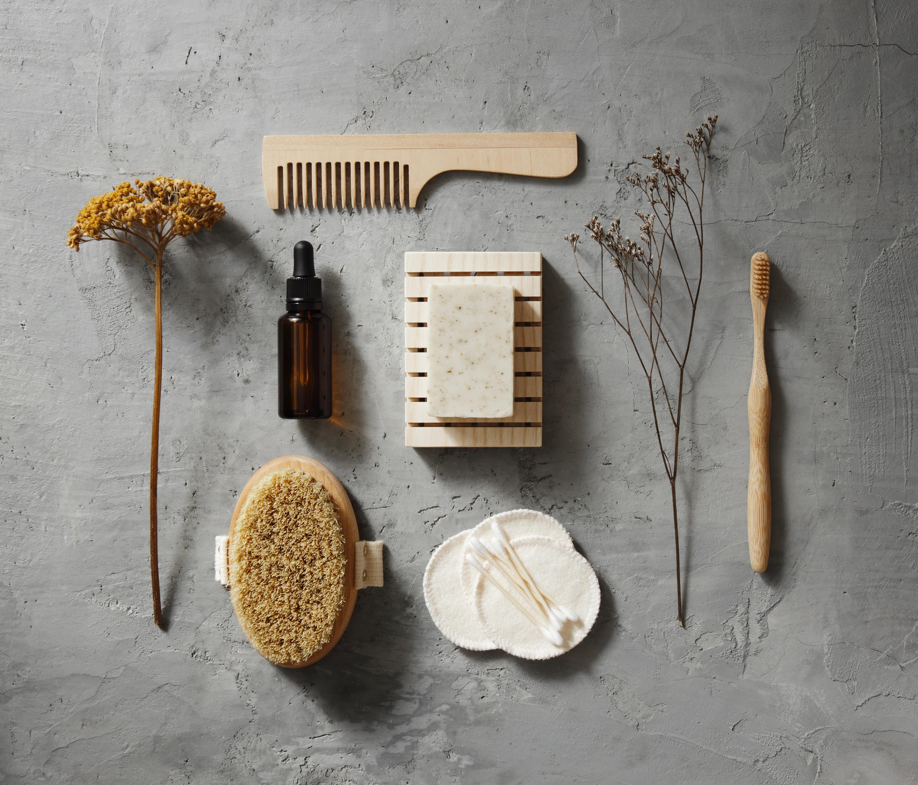
Bonus
Give three examples of international etiquette
Give three examples of bathroom facilities

Slide 13
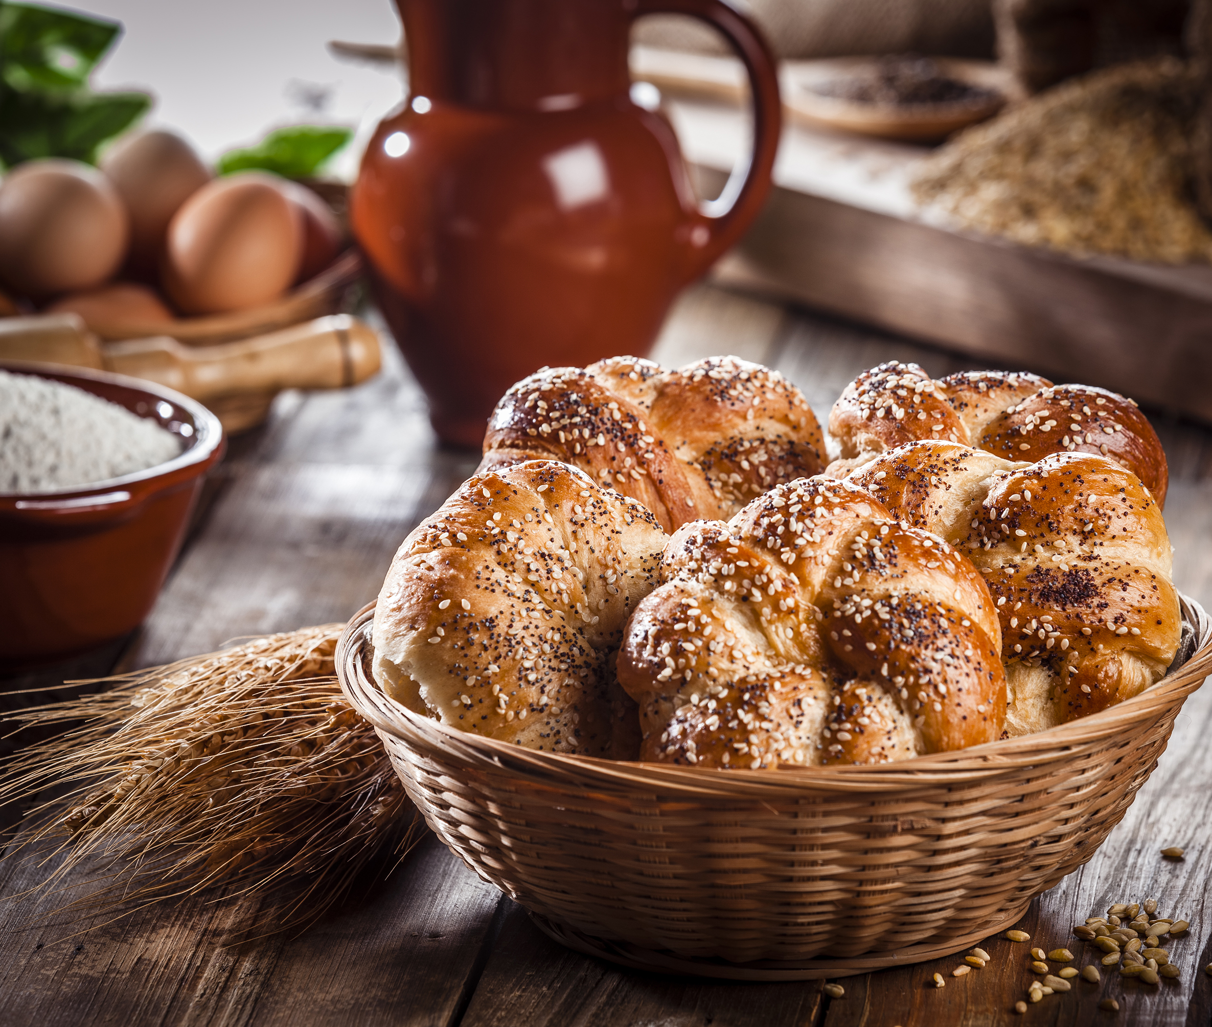
Bonus
What is included in English breakfast?
What is included in continental breakfast?

Slide 14
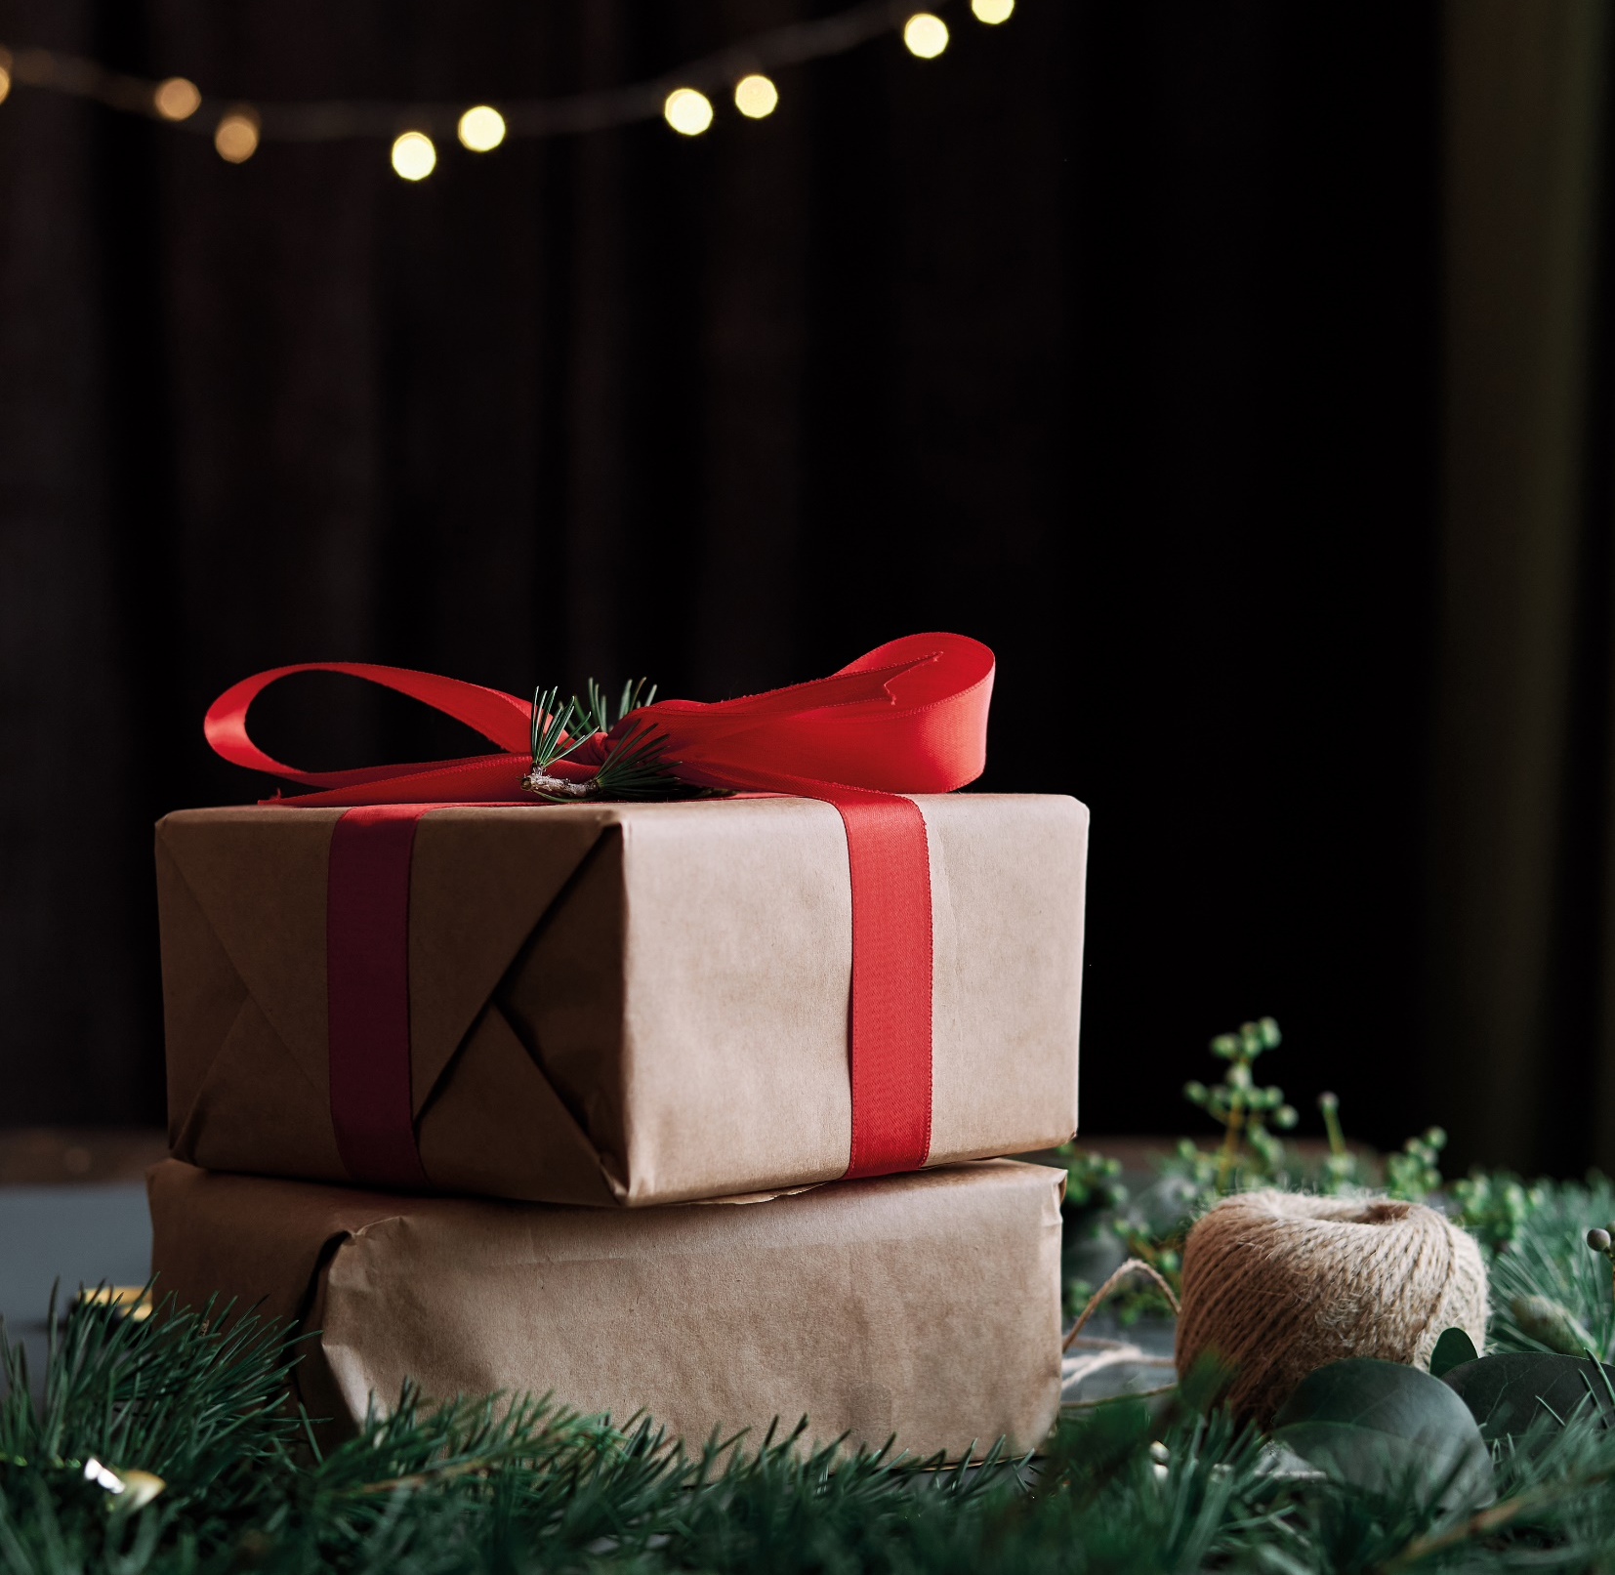
Write a letter to Santa!
Bonus

Slide 15

Merry Xmas and Happy New Year!

